Slide 1
Face Detection Algorithms
Algorithm- Viola-Jones Haar Cascade Classifier
It is a machine learning based approach where a cascade function is trained from a lot of positive and negative images. It is then used to detect objects in other images.
Here we will work with face detection. Initially, the algorithm needs a lot of positive images (images of faces) and negative images (images without faces) to train the classifier. Then we need to extract features from it. For this, Haar features shown in the below image are used. They are just like our convolutional kernel. Each feature is a single value obtained by subtracting sum of pixels under the white rectangle from sum of pixels under the black rectangle.

Slide 2
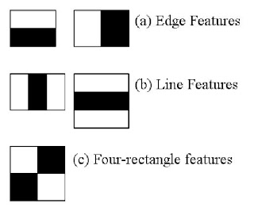
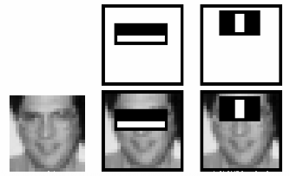

Slide 3
Haar Cascade Classifier method is famously used as OpenCV provides pretrained Haar cascade models to detect faces and eyes in an image.
A CascadeClassifier Object is created and the necessary XML file is loaded.
The co-ordinates of where the face might be present is detected by using ‘detectMultiscale()’ which takes three arguments –
1) the input image converted into grayscale as faces in this algorithm detects faces in grayscale but the ouput image is in it’s original form.
2) scaleFactor - Parameter specifying how much the image size is reduced at each image scale. Suppose, the scale factor is 1.03, it means we're using a small step for resizing, i.e. reduce size by 3 %, we increase the chance of a matching size with the model for detection. Image shown-

Slide 4
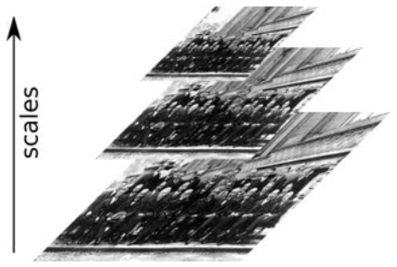
3) minNeighbors - Parameter specifying how many neighbors each candidate rectangle should have to retain it. This parameter will affect the quality of the detected faces: higher value results in less detections but with higher quality.

Slide 5
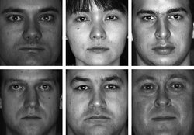
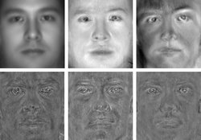
Algorithm – Principal Component Analysis (PCA)
PCA reduces dimension by focusing on the pixels with most variation.It reduces dimension and the following reduced dimension accounts for most variation in data. It uses the concept of Eigenfaces.
Eigenfaces refers to an appearance-based approach to face detection that seeks to capture the variation in a collection of face images and use this information to encode and compare images of individual faces in a holistic (as opposed to a parts-based or feature-based) manner.
The motivation of Eigenfaces is twofold: 1) Extract the relevant facial information, which may or may not be directly related to human intuition of face features such as the eyes, nose, and lips. One way to do so is to capture the statistical variation between face images. 2) Represent face images efficiently. To reduce the computation and space complexity, each face image can be represented using a small number of parameters.

Slide 6
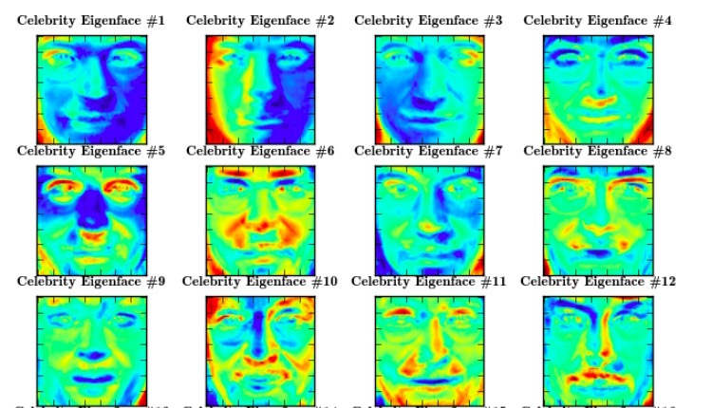
Algorithm – Fisher’s Linear Discriminant Analysis (LDA)
LDA is like PCA, but it focuses on maximizing the seperability among known cateogaries. So it’s more useful for face recognition.
It uses a concept of Fisherfaces. Fisherfaces implements a face recognition framework for Python with preprocessing, feature extraction, classifier and cross validation. Basically, it lets you measure, save and load models for face detection in videos (such as webcam feeds). You can also optionally validate your model to see the performance you can expect.
However, the script does not work perfectly on not preprocessed input pictures. In order to generate more robust recognition, your input must be aligned in the exact same manner as specified in the training set.

Slide 7
Algorithm – Multi-task Cascaded Convolutional Neural Network
(MTCNN)
MTCNN is popular because it achieved then state-of-the-art results on a range of benchmark datasets, and because it is capable of also recognizing other facial features such as eyes and mouth, called landmark detection.
The network uses a cascade structure with three networks; first the image is rescaled to a range of different sizes (called an image pyramid), then the first model (Proposal Network or P-Net) proposes candidate facial regions, the second model (Refine Network or R-Net) filters the bounding boxes, and the third model (Output Network or O-Net) proposes facial landmarks.
The model is called a multi-task network because each of the three models in the cascade (P-Net, R-Net and O-Net) are trained on three tasks, e.g. make three types of predictions; they are: face classification, bounding box regression, and facial landmark localization.
The three models are not connected directly; instead, outputs of the previous stage are fed as input to the next stage.

Slide 8
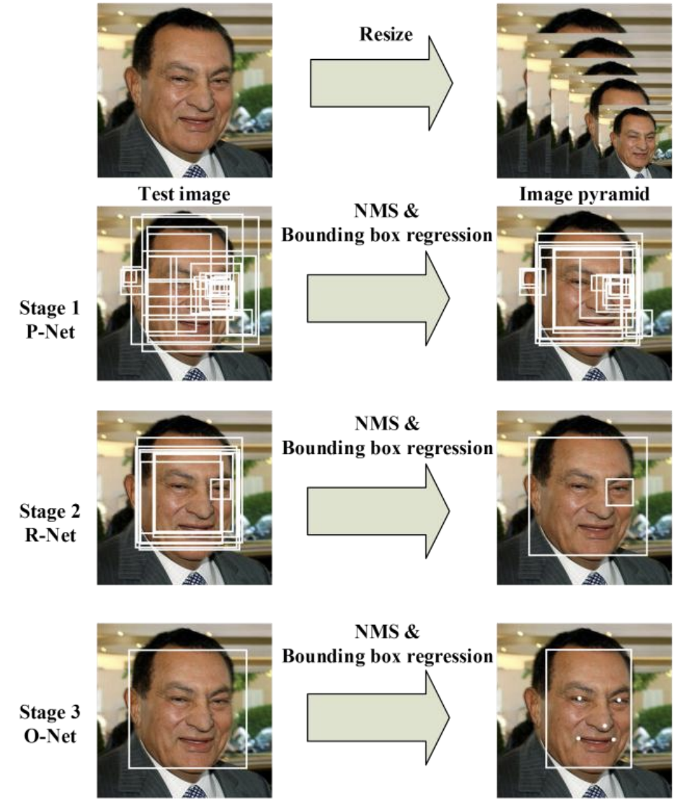
Similar to ‘scaleFactor’ in Haar Cascade
Facial Region determination/ Facial classification
Bounding Box Regression
Regression – Predicts input using previously fed labelled data.
Facial Landmark Localization

